Slide 1
Micro Credit Loan Fraud Prediction
Helping to find the right customer

Slide 2
Problem Statement And Understanding
A telecom company is collaborating with an MFI to provide micro-credit on mobile balances to be paid back in 5 days for its customers.
In order to improve the selection of customers for the credit, the client wants some predictions that could help them in further investment and improvement in selection of customers.
The Consumer is believed to be defaulter if he deviates from the path of paying back the loaned amount within the time duration of 5 days.
For the loan amount of 5 (in Indonesian Rupiah), payback amount should be 6 (in Indonesian Rupiah), while, for the loan amount of 10 (in Indonesian Rupiah), the payback amount should be 12 (in Indonesian Rupiah).
This is a binary classification problem with target classes 0 and 1.

Slide 3
Exploratory Data Analysis
This is a binary classification problem with numeric binary target variable. The target variable contains 0s and 1s.
Variable Data-types:
The ‘pdate’ and ‘pcircle’ variables are of object type.
All the other variables are of numeric type.
Null Values: There are no Null values.
Shape: There are 209593 records and 35 features + 1 target variable in the data.
Imbalance dataset: The dataset contains 87.5% records with target class as 1 and 12.5% records with target class 0.

Slide 4
Exploratory Data Analysis Cont.
Descriptive Statistics:
There are some unrealistic values in the dataset.
All the variables are either moderately or highly skewed. The means of the variables are larger than their medians.
The variables are in different scales.
Some of the variables have high standard deviation.
There are some extreme outliers in the data based on the max values and the values in the 1st, 2nd and 3rd Quartiles.
Extensive Data cleaning was performed on majority of the variables.

Slide 5
Visualizations

Slide 6
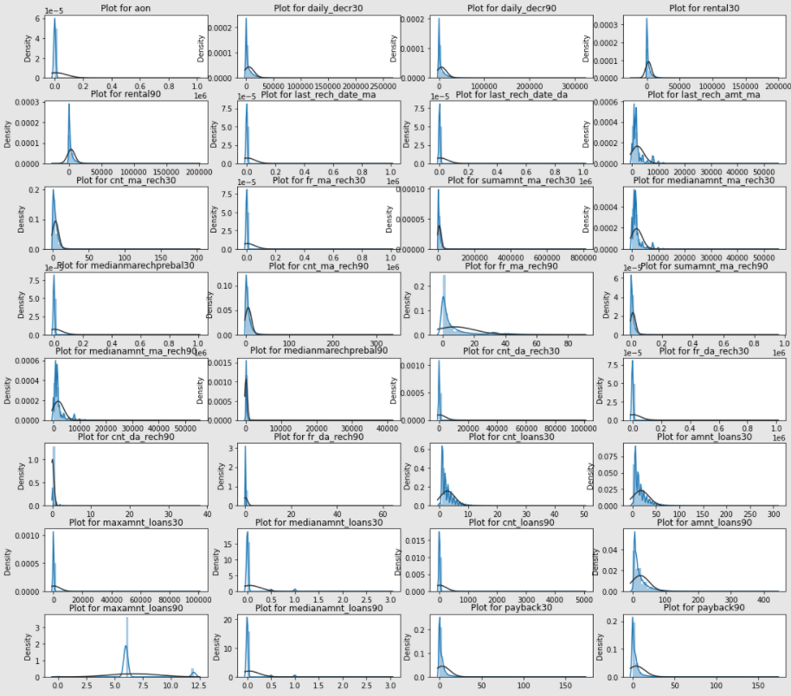
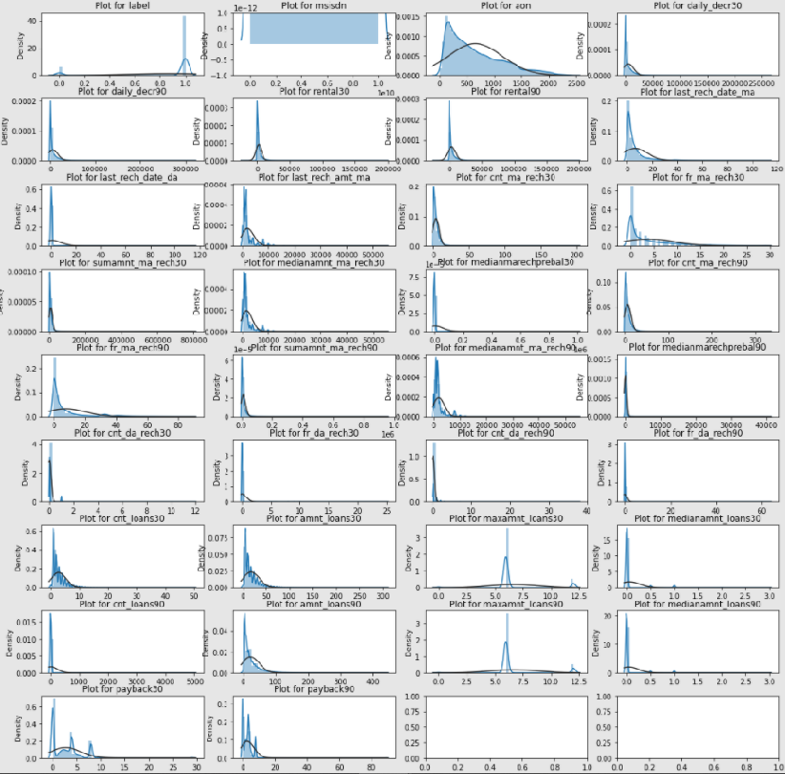
Distribution of the Variables before(left) and after(right) cleaning

Slide 7
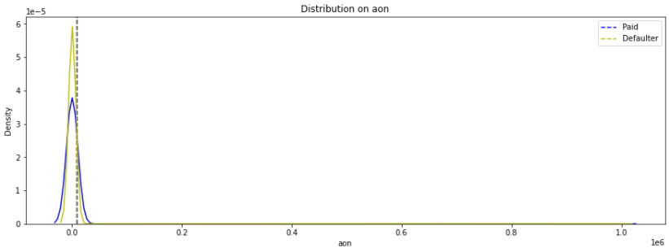
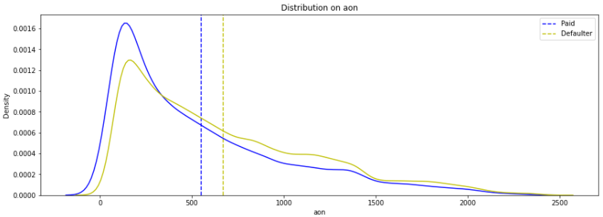
aon - Age on cellular network
After cleaning the date, the 'aon' variable can distinguish between the labels 1 and 0.
The tenure of defaulters on an average is lesser than the tenure of defaulters on the cellular network.

Slide 8
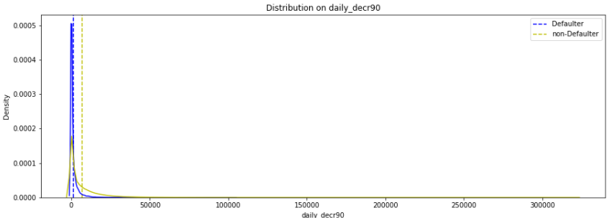
‘daily_decr30’
Most of the values are pretty close.
The labels 0 and 1 are somewhat distinguished.
The daily spent amount for 30 days for defaulters is lesser than non defaulters on an average.

Slide 9
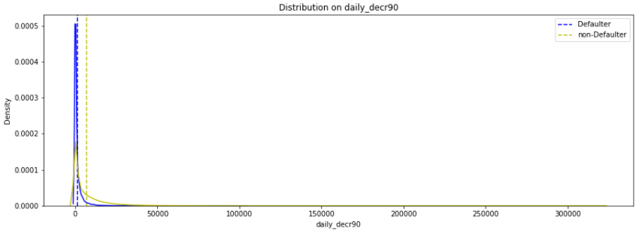
‘daily_decr90’
Most of the values are pretty close. The labels 0 and 1 are somewhat distinguished.
The daily spent amount for 90 days for defaulters is slightly lesser than non defaulters on an average.

Slide 10
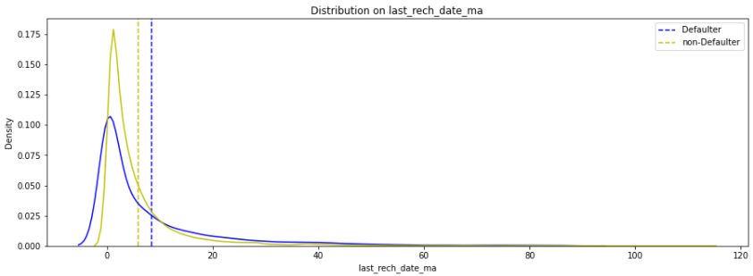
‘last_rech_date_ma’
The classes 0 and 1 are showing some differences.
The last recharge date on the main account is slightly lesser for non-defaulters than defaulters.

Slide 11
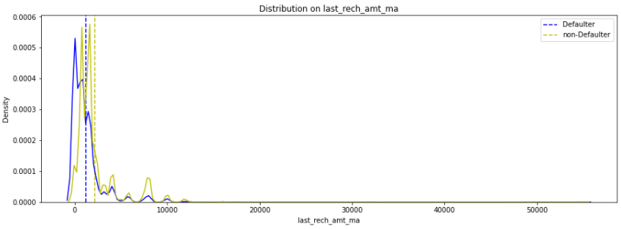
‘last_rech_amt_ma’
The classes 0 and 1 in ‘label’ in distributions are showing some difference.
The last recharged amount on an average for defaulters is lesser than non-defaulters.

Slide 12
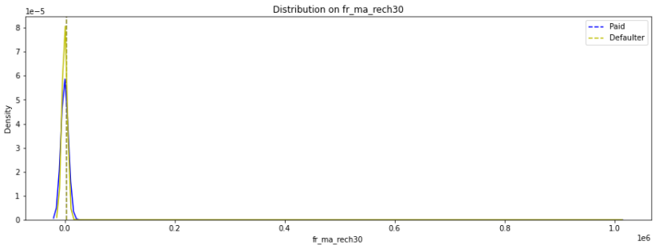
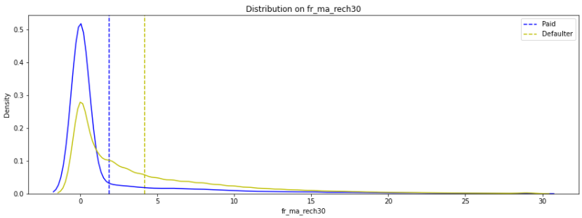
‘fr_ma_rech30’
We can see that the distribution of labels 0 &1 and well distinguished in the fr_ma_rech30 after cleaning.Left is before cleaning and right is after cleaning.
The frequency of recharging the main account done for 30 days by non defaulters is greater than defaulters.

Slide 13
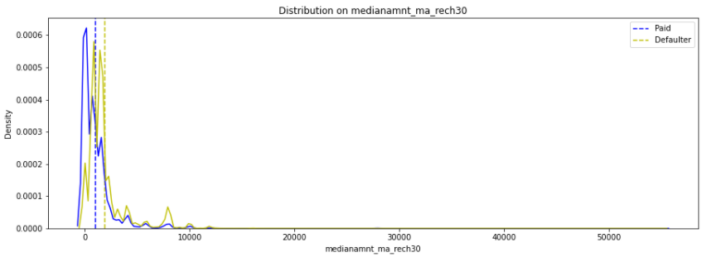
‘medianamnt_ma_rech30’
The graph above shows that the Defaulters have done a slightly lesser amount of recharges to their main account than non-defaulters.

Slide 14
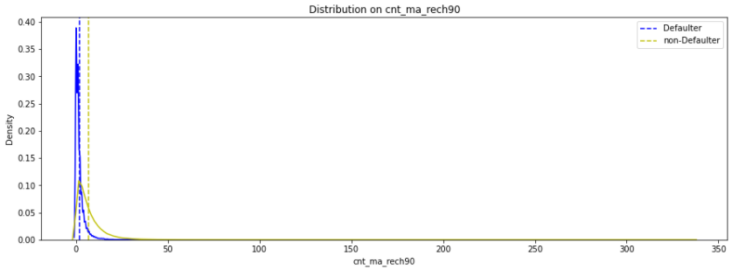
‘cnt_ma_rech90’
On an average, the number of recharges done by the defaulters over 90 days is slightly lesser than the number of recharges done by non-defaulters.

Slide 15
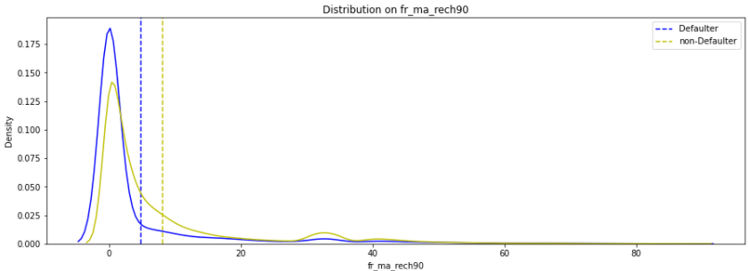
‘fr_ma_rech90’
The classes 0 and 1 show some distinctions.
On an average, the frequency of recharges done by defaulters on the main account over a period of 90 days is lesser than that of non-defaulters.

Slide 16
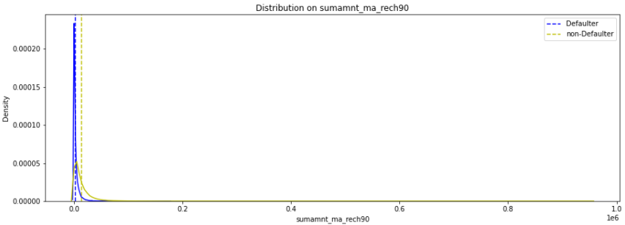
‘sumamnt_ma_rech90’
On an average, the total amount of recharge done by defaulters over 90 days is slightly lesser than done by non-defaulters.

Slide 17
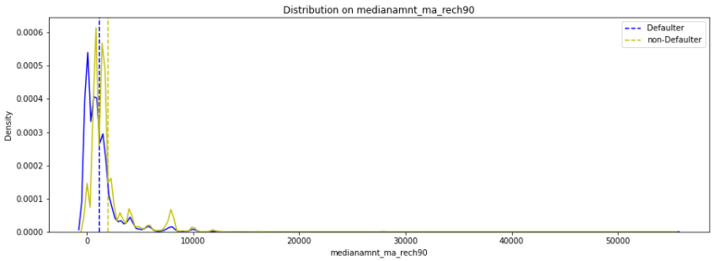
‘medianamnt_ma_rech90’
The label 0 and 1 distribution in medianamnt_ma_rech90 show some difference.
On an average, the Median amount of recharge done by defaulters on the main account over 90 days is slightly lesser than that done by non-defaulters.

Slide 18
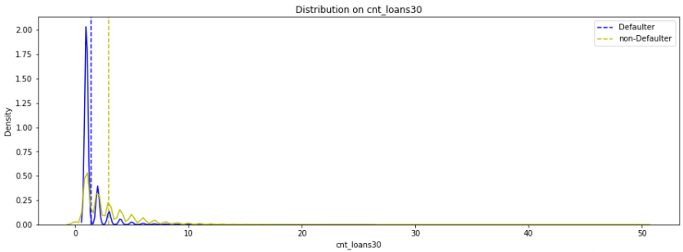
‘cnt_loan30’
The cnt_loans30 distribution shows some difference between labels 0 and 1
On an average, the defaulters have taken a lesser number of loans over 30 days than non defaulters.

Slide 19
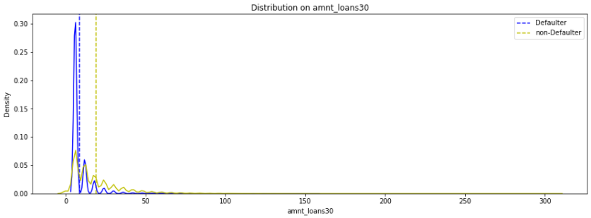
‘amnt_loans30’
The amnt_loans30 distribution shows good difference between labels 0 and 1.
The total amount of loans taken by defaulters in the last 30 days is lesser than that of non-defaulters on an average.

Slide 20
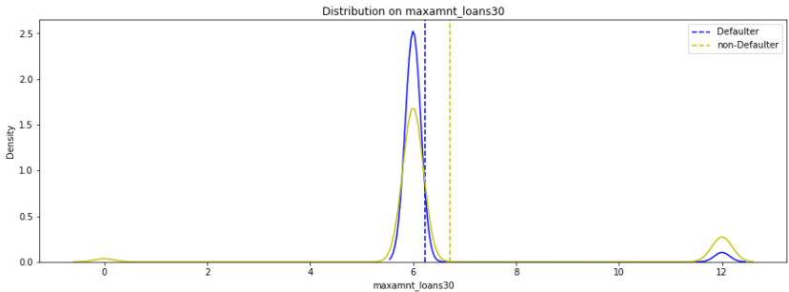
‘maxamnt_loans30’
The distribution means are showing some distinction between labels 0 and 1 for maxamnt_loans30.
The maximum amount taken as loan by defaulters is on an average lesser than the non-defaulters.

Slide 21
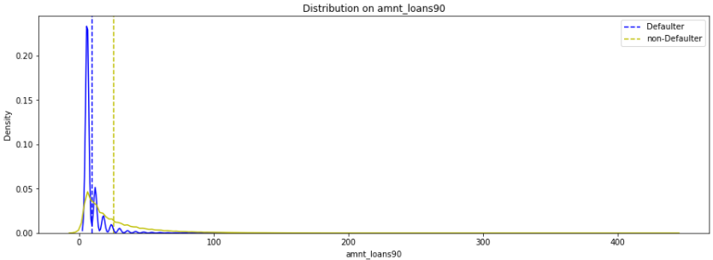
‘amnt_loans90’
The distributions between 0 and 1 labels show good difference in amnt_loans90.
On an average, the total amount of loans taken by the defaulters is lesser than non-defaulters.

Slide 22
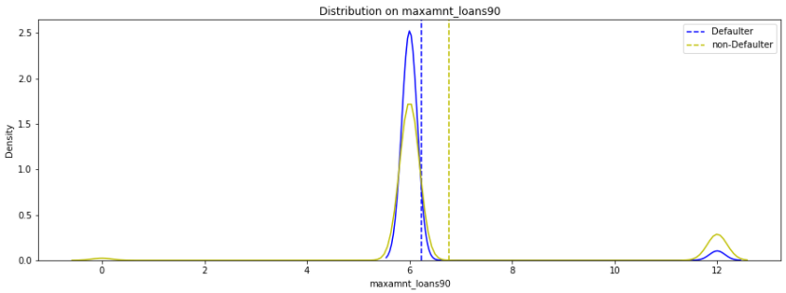
‘maxamnt_loans90’
On an average, the maximum amount of loans taken by defaulters over a period of 90 days is lesser than the maximum amount of loans taken by non-defaulters.

Slide 23
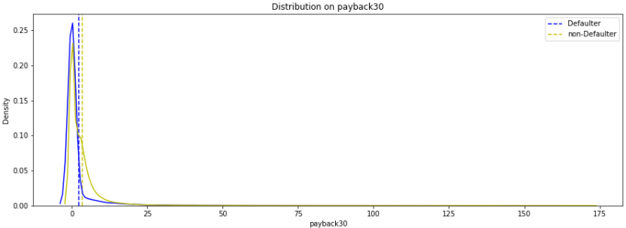
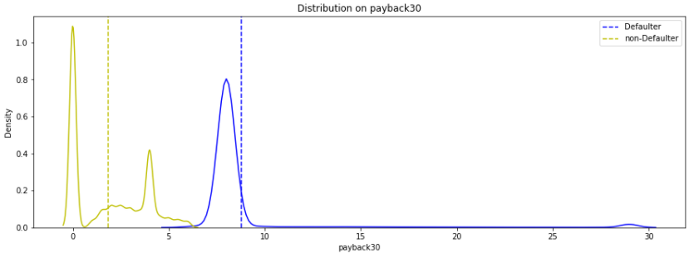
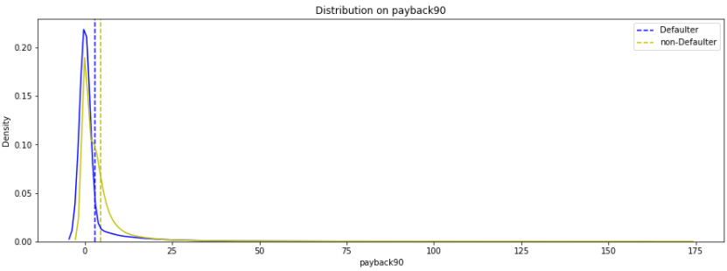
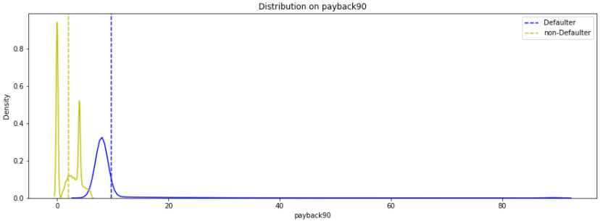
‘PayBack’ Before Cleaning(left) and After Cleaning(right)

Slide 24
Pay Back Observations
After cleaning the payback variables show pretty good difference between labels 0 and 1.
On an average, the time taken by defaulters to pay back the loan is greater than the time taken by non-defaulter to pay back the loan over a period of 30 or 90.

Slide 25
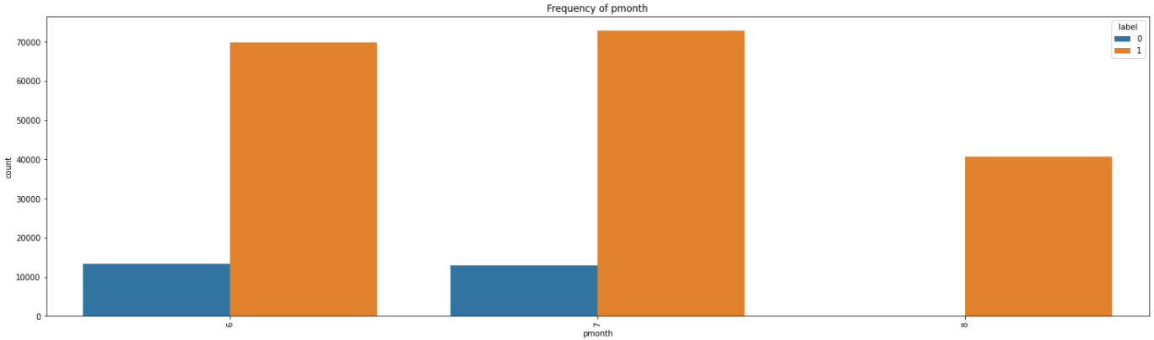
pdate - Month
The month of 6 and 7 have some defaulters. Month 8 doesn't have any defaulters.

Slide 26
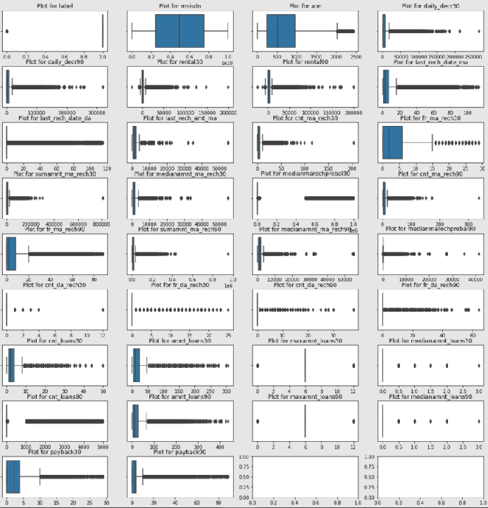
Outliers
As per Z-Score method, the Total percentage of outliers in the data is 25.6%.
As per IQR method, the total percentage of extreme outliers in the data is 46.6%.
Since there is a large percentage of data as outliers, these outliers could be natural outliers.

Slide 27
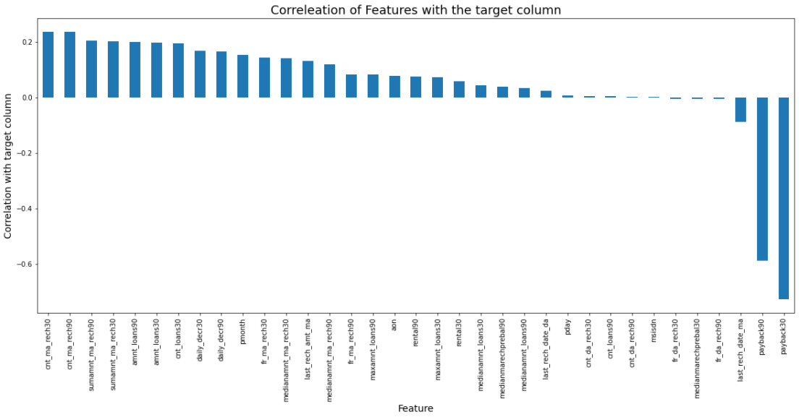
Correlation
The payback30 and payback90 show strong negative correlation with the target variable 'label'.

Slide 28
Assumptions Made for Data Cleaning activities
Mobile numbers are integers.
Age or number of days are never negative.
Extremely large positive values are data entered in either minutes or seconds instead of days.
Amount spent cannot be negative.
Larger amounts could be natural variations in the data.
Frequency within 30 will ne less than 30.
Frequency within 90 will be less than 90.
5 and 10 Indonasian Rupiah are the only loan amount options.
There could be records with 0 as the loan amount.
The customer will be a defaulter if they don't pay back the loan amount within 5 days of issuing the loan. So, the Average payback value will be less than or equal to 5 for records with label = 1 and Average payback value to be greater than 5 for records with label = 0.

Slide 29
Steps taken to complete the Project
Performed data cleaning based on the information provided and assumptions made.
Performed quantile range based scaling transformation using ‘RobustScaler’, since there were outliers in the data and the variables were in different scales.
Performed Yeo Johnson based transformation using ‘PowerTransformer’ to remove the skewness in the data.
Trained and validated different Machine Learning classification models(simple and ensemble models) to select a suitable model.
Chose the final model based on Log-loss, weighted ROC-AUC curve and confusion matrix metics.

Slide 30
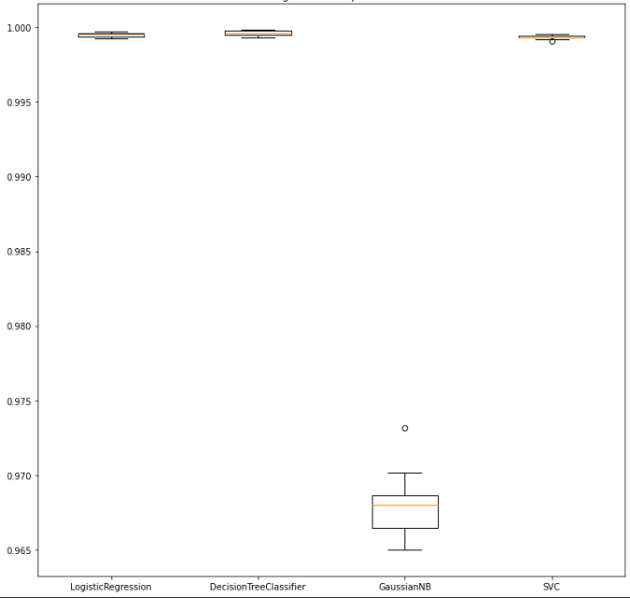
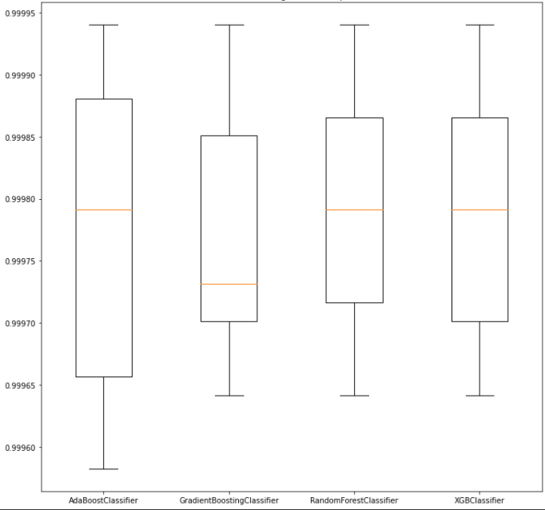
Model score comparison
Simple Models(left) and Ensemble models(right)

Slide 31
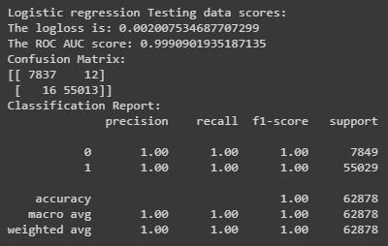
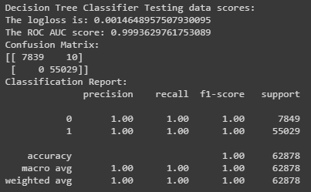
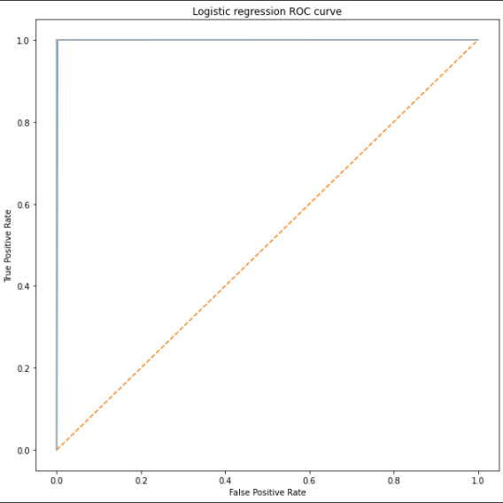
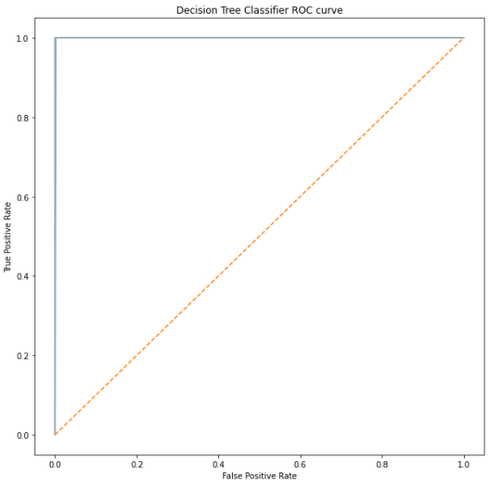
Comparing finalized models’ test scores

Slide 32
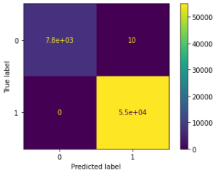
Finalized Model
The final model used is DecisionTreeClassifier
The tuned hyper parameters used are:
cpp_alpha=0.0
class_weight=’balanced
criterion=’entropy
max_depth=5
max_features=None
max_leaf_nodes=None,
min_impurity_decrease=0.0
min_impurity_split=None
min_samples_leaf=1
min_samples_split=2
min_weight_fraction_leaf=0.0
splitter=’best’

Slide 33
Conclusion
The Decision Tree Classifier is giving slightly a better result than Logistic Regression. The log_loss of DecisionTree is slightly lesser than Logistic Regression. The Confusion matrix also shows slightly better results for Decision Tree in the test set.
Both models are able to learn the data pretty well. However, DecisionTree based models are robust to outliers. There were lot of outliers in the dataset.
The performance shows low bias and low variance.
The target has good correlation with pay back, however, the other variables are also showing some correlation with target.

